Slide 1
Cluster Analysis On Dynamic Graphs
FINAL YEAR PROJECT
Presented by : Samuel Eng
Supervised by Asst Prof Kelly

Slide 2
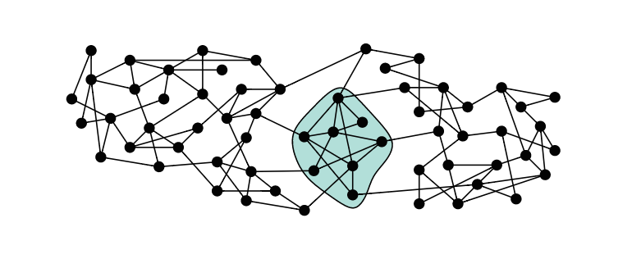
Introduction
Finding patterns in data, or grouping similar groups of data-points together into clusters.
A graph cluster can be described as a maximal clique of a graph.
Clustering also means grouping vertices based on the edge structure, forming many vertices within one cluster and just a few edges between clusters.

Slide 3
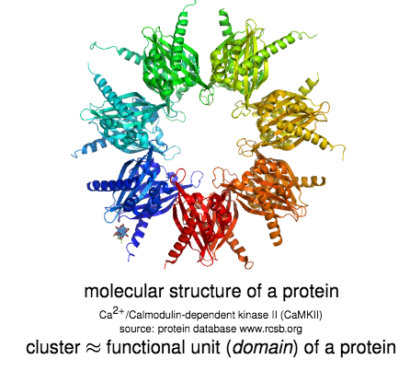
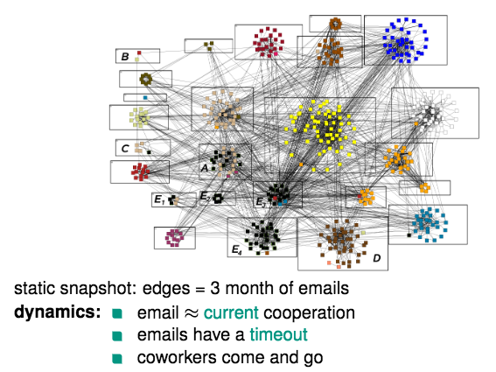
Identifying Clusters

Slide 4
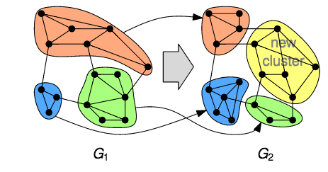
Dynamic Networks
Capturing dynamic nature:
Snapshots differing in a bunch of vertex and edges change given a time sequence.

Slide 5
Dynamic changes
173 nodes and 137 edges
116 nodes and 116 edges
Time step 1: [0,100]
Time step 2: [100, 200]

Slide 6
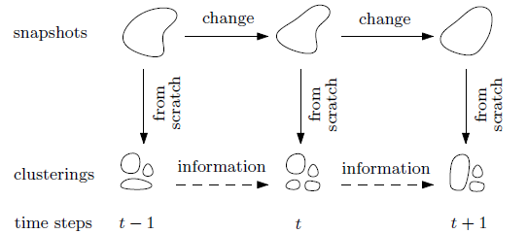
How to cluster dynamically?
To streamline the evolutionary clustering strategy in evolving graphs, static clustering approach shall be applied from scratch on snapshots.
To interpret the evolution, approaches include seeking series of similar clusters in consecutive snapshots, identifying critical events where clusters split or merge.

Slide 7
Dynamic Datasets
temporal edges (u,v,t,d)
In order to have different snapshots of a dynamic graph, the time dimension t is divided to a set of intervals, for example, [1, 50], [51, 100], [101, 150]
For each of the interval etc; [1, 50], a graph snapshot G1 is constructed with all the temporal edges (u,v,t,d) satisfying the conditions (1<=t<=50) and (t+d<=50) as edges of the snapshot.
This allows multiple snapshots G1, G2, ...Gi of the same dynamic graph.
Source: http://konect.uni-koblenz.de/networks/elec
The first line consists of two integers: number of vertices, number of temporal edges.
u = starting vertex
v = ending vertex
t = the time when this edge occurs
d = duration for this edge to exist
The edges are sorted in time t.

Slide 8
Constructing the graph
An adjacency matrix is a means of representing which vertices (or nodes) of a graph are adjacent to which other vertices.
An adjacency matrix is a two dimensional array in which the elements indicate whether an edge is present between two vertices.
An edge between two vertices is indicated with a 1; while the absence of a edge is indicated by a 0.

Slide 9
Algorithms Used
Markov Clustering
Multilevel Regularized Markov Clustering
Chinese Whispers Clustering

Slide 10
Markov Clustering Algorithm
Main steps
Expansion: Spreads the flow out of a vertex.
Inflation: Strengthens intra-cluster flow and
weakens inter-cluster flow.
Pruning: Remove the entries below
threshold value and renormalize.
Convergence: After several iterations, most of the nodes will find an attractor node where all their flows are directed at as there will only be one nonzero entry per column in the matrix. The algorithm can then stop and interpret clusters. Attractors and nodes that are attracted will be grouped as a single cluster.
Source: Van Dongen, S. (2000) Graph Clustering by Flow Simulation

Slide 11
Adding Self Loops
Small simple path loops can complicate things.
There is a strong effect that odd powers of expansion obtain their mass from simple paths of odd length, and likewise for even.
Adds a dependence to the transition probabilities on the parity of the simple path lengths.
Source: Van Dongen, S. (2000) Graph Clustering by Flow Simulation
The addition of self looping edges on each node resolves this. – Adds a small path of length 1, so the mass does not only appear during odd powers of the matrix.

Slide 12
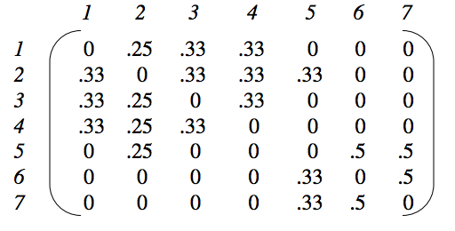
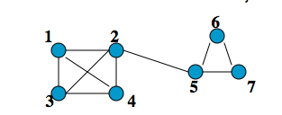
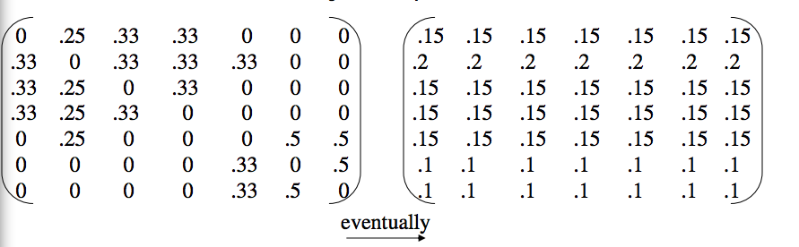
Markov Chain
Source: Kathy Macropol, Uc santa barbara

Slide 13
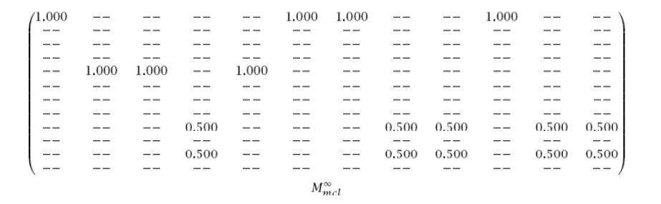
Interpreting results
Source: Kathy Macropol, Uc santa barbara

Slide 14
Analysis
Time complexity : O(n^3) where n is the number of vertices.
The main issue lies with the expand function where three levels of iterations are performed
The number of steps for convergence is shown to be from 10 to 100, but it cannot be determined by any means.
Limitations:
Lacking scalability. Sparse matrices is costly for the first few iterations and furthermore, computing large graphs is not feasible.
Due to over-fitting, the divergence of flows between neighbor nodes is not penalized by the algorithm. Result: High fragmentation of clusters.

Slide 15
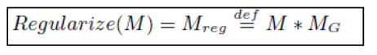
Regularized function
Replaces expansion function: During Expansion, the flow matrix is multiplied by the initial canonical transition matrix. This prevents the columns from diverging too much and hence not producing separate clusters.
Still suffers from scalability problem
Possible Solution:
Multi-Level Regularized Markov Clustering

Slide 16
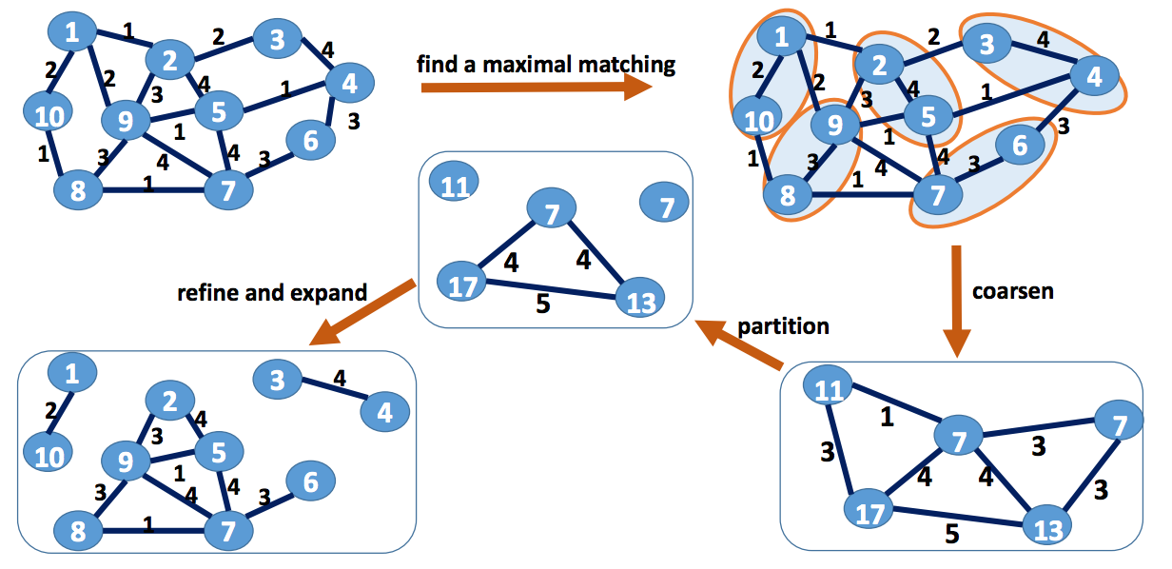
Multilevel Regularized Markov Clustering Algorithm
Source: Venu Satuluri, Ohio State University, 2009

Slide 17
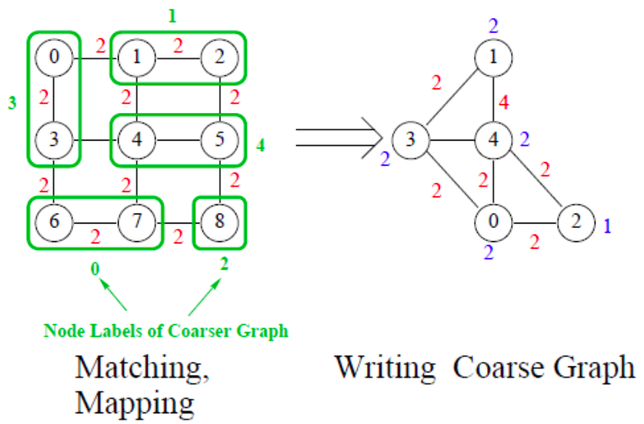
Maximal matching
Source: Zardosht Lasheff, MIT

Slide 18
Curtailed RMCL
Beginning with the coarsest graph, R-MCL is run for a few iterations (Curtailed RMCL). In the implementation it is ran 2 times.
The flow values at the end of this Curtailed R-MCL run are then projected on to the refined graph of the current graph.
R-MCL is run again for a few iterations on the refined graph, and this is repeated until we reach the original graph.
Why not just run full R-MCL on the coarse graphs to save time?
Large number of iterations of R-MCL will lead to early convergence and thus at the successive uncoarsening levels we will get the same convergent flows.

Slide 19
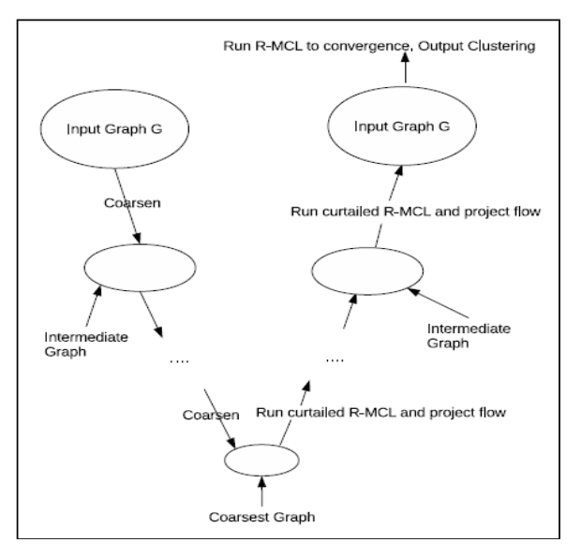
RMCL on initial graph
With flow values initialized from the previous phase, R-MCL is run on the final graph until convergence. The flow matrix at the end is converted into a clustering in the usual way, with all the nodes that flow into the same “attractor” node being assigned into one cluster.

Slide 20
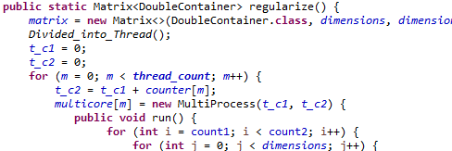
Multi-core processing
By parallelizing the most time consuming region of the sequential MLR-MCL algorithm.
MLR-MCL’s regularized function
Same with MLR-MCL’s coarsening function.
1 second, on average there are 65536 iterations.
Have a speed up relative to the cores in a computer.

Slide 21
MLR-MCL Analysis
Regularized step equivalent to expansion step in MCL.
Subsequent regularized steps can be approximated as O(k*|E|) where k is the average number of nonzero entries per column.
After the first initial RMCL is run on the coarsest graph first there are rarely more than a few tens nonzero entries per column.
The overall time complexity can be approximated to be

Slide 22
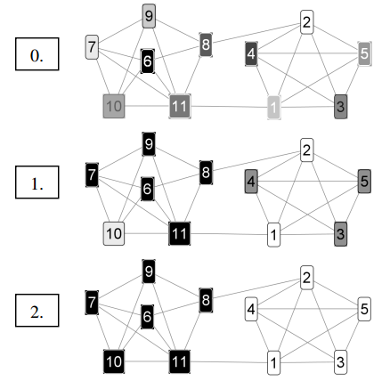
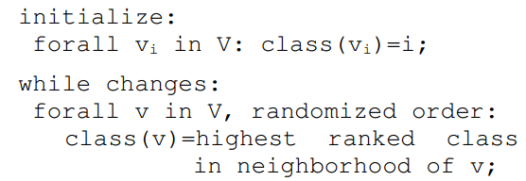
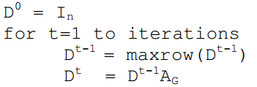
Chinese Whispers Algorithm
A randomized graph-clustering algorithm, which is time-linear in the number of edges.
Pseudo code
Source: Chris Biemann, University of Leipzig

Slide 23
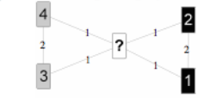
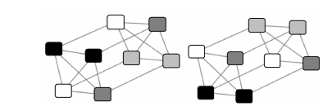
Converge Problem
In this case, where does middle node go?
Ties, however, do not play a major role in weighted graphs.
Solution:
Random assignment.
Source: Chris Biemann, University of Leipzig
Oscillating classes
Solution:
• Random mutation
• Keep class
• Continuous update

Slide 24
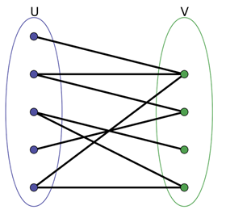
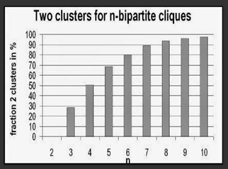
Analysis
Random order processing
Possible ties

Slide 25
Performance

Slide 26
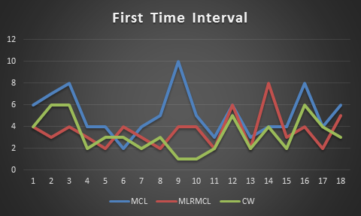
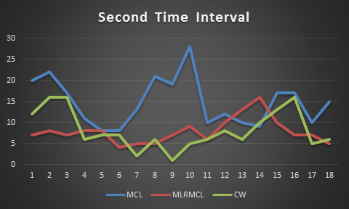
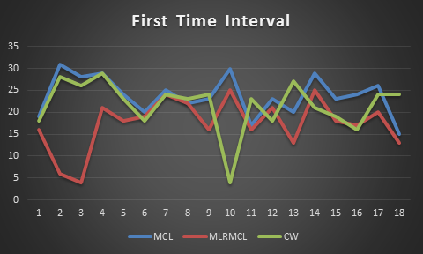
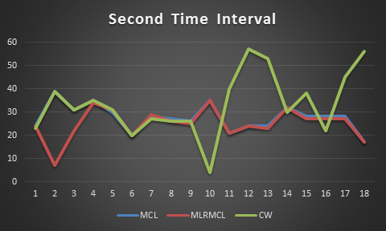
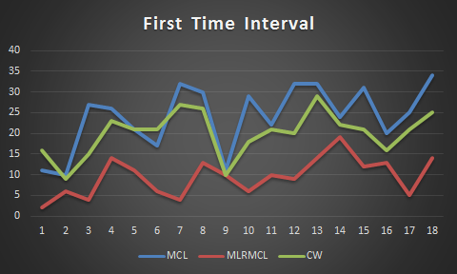
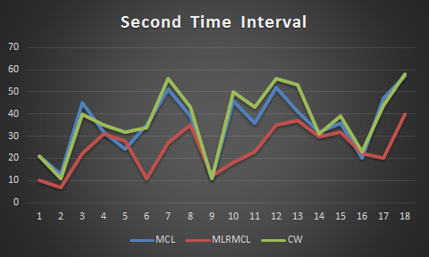
Number of Clusters involved
Graph 1
Graph 2
Graph 3

Slide 27
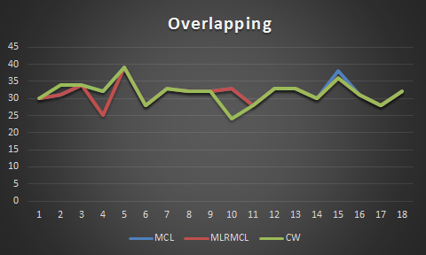
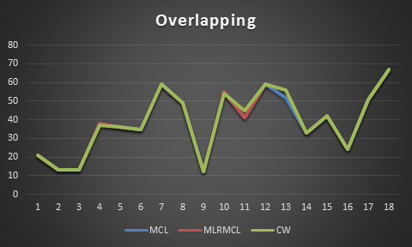
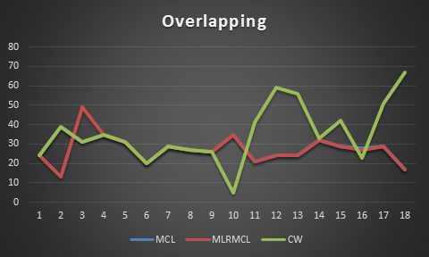
Number of overlapping nodes
Graph 1
Graph 2
Graph 3

Slide 28
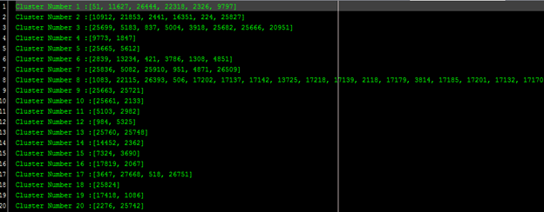
Implementation Step 1: Displaying Cluster Results

Slide 29
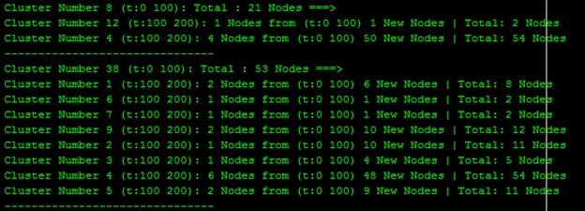
Step 2: Tracing Cluster Information

Slide 30
Step 3: Tracing individual nodes

Slide 31
Constructing the visual model
Using Graph Stream API and JavaFX.
Integrated with the mentioned algorithms.
Present the algorithm results in a clear and readable form.
Functions
Extending timeline
Threshold
Showing cluster information and edge information (Interactive)
Table showing detailed results
Tracing individual nodes
Saving image

Slide 32
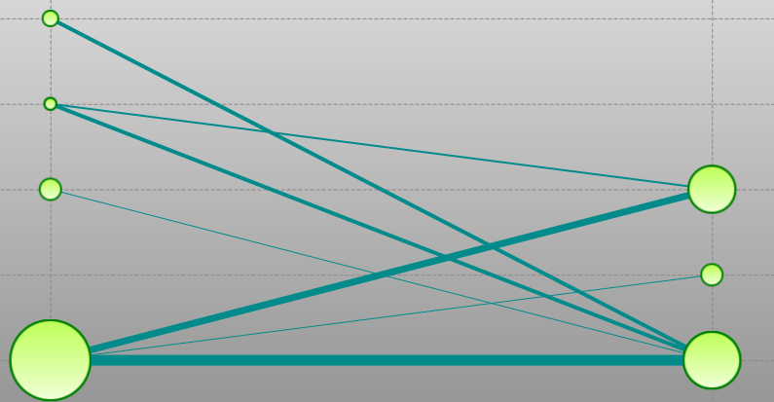
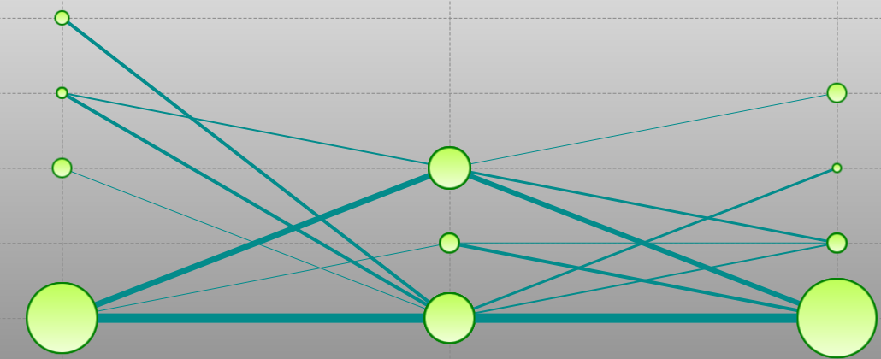
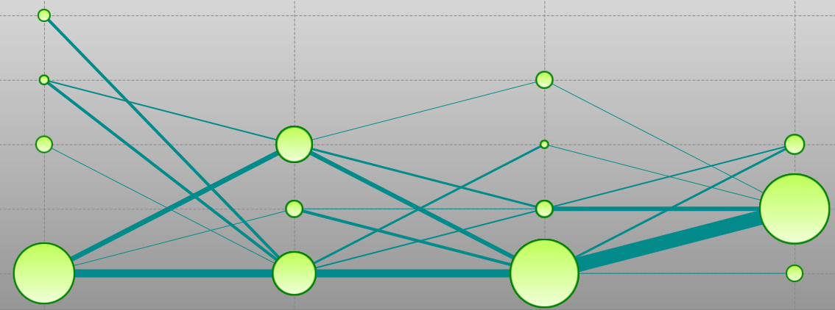
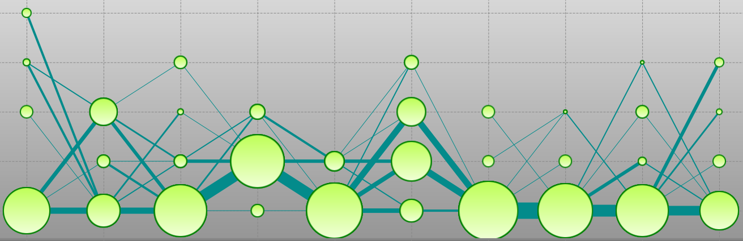
Extending Time Line MLRMCL cluster results
0 100,100 200
0 100,100 200,200 300
0 100,100 200,200 300,300 400
0 100,100 200….900 1000

Slide 33
Threshold
*Clusters as similar if the similarity value exceeds a given threshold
First time stamp is denoted by totalParentNodes and overlappingChildNodes indicates similar nodes that appeared in both time intervals.
To calculate the threshold, the formula
(overlappingNodes / totalParentNodes) * 100.0 is used.

Slide 34
0% Threshold
30% Threshold

Slide 35
Tracing individual nodes
Visual model shows cluster relationships
Internal Structure
Aims at identifying critical events where nodes for instance, appear, survive, disappear.
Temporal tracing helps highlight relations between feature patterns and graph properties as it shows the evolution of the global structure of the graph.

Slide 37
Main Development Model
Matrix
Utils
Multithreading
Algorithm
Visual Model

Slide 38
Live Demo

Slide 39
Summary Part 1
Clustering dynamic networks => detecting and visualizing the evolution of clusters over time.
Approach => snapshots (sequences of static networks).
Clustering algorithms implemented:
Markov Clustering
Multilevel Regularized Markov Clustering + multicore processing
Chinese Whispers
Algorithms’ Performance.

Slide 40
Summary Part 2
Visual Model Implemented
Visualize the evolution over time using a threshold as a reference for constructing links between time step clusters.
Comparison results.
First step towards a unified foundation for generalized clustering of graphs, including dynamics.
Future work can be dedicated to utilizing, refining and further developing the visual model specifically in dynamic networks.

Slide 41
THANK YOU FOR LISTENING!

